Slide 1
CS-4067 DevOps Project
Submitted to: Mr. Murtaza Munawar Fazal
Section: BCS-7B
Done By: Ayesha Zia 20K-0414
Eisha Fatima 20K-0383
Sabah Mawani 20K-0393

Slide 2
Source Code Repository: GitHub

Slide 3
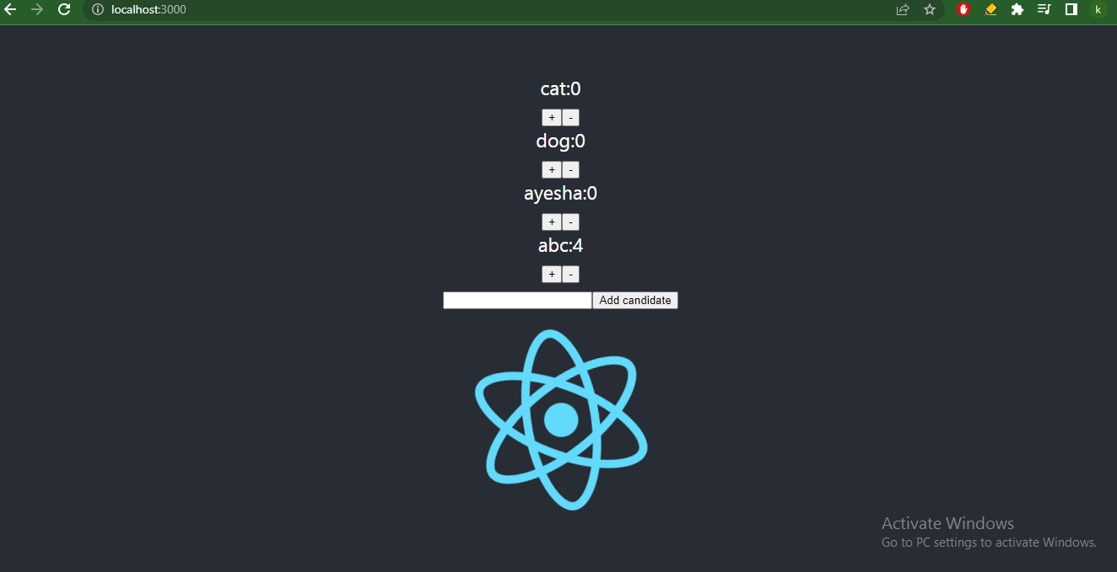
PROJECT OVERVIEW A Basic Voting App

Slide 4
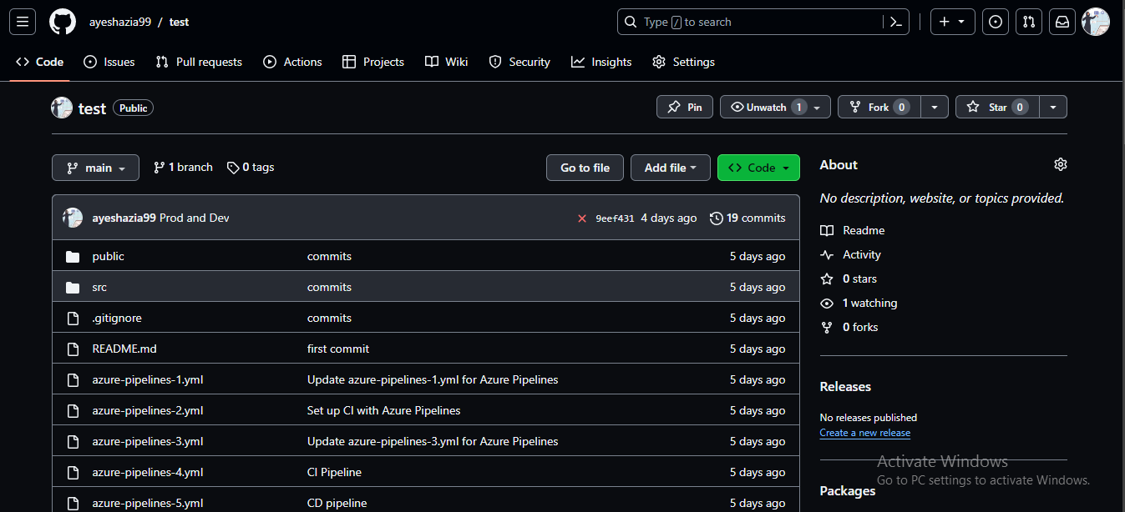
Frontend(GitHub)

Slide 5
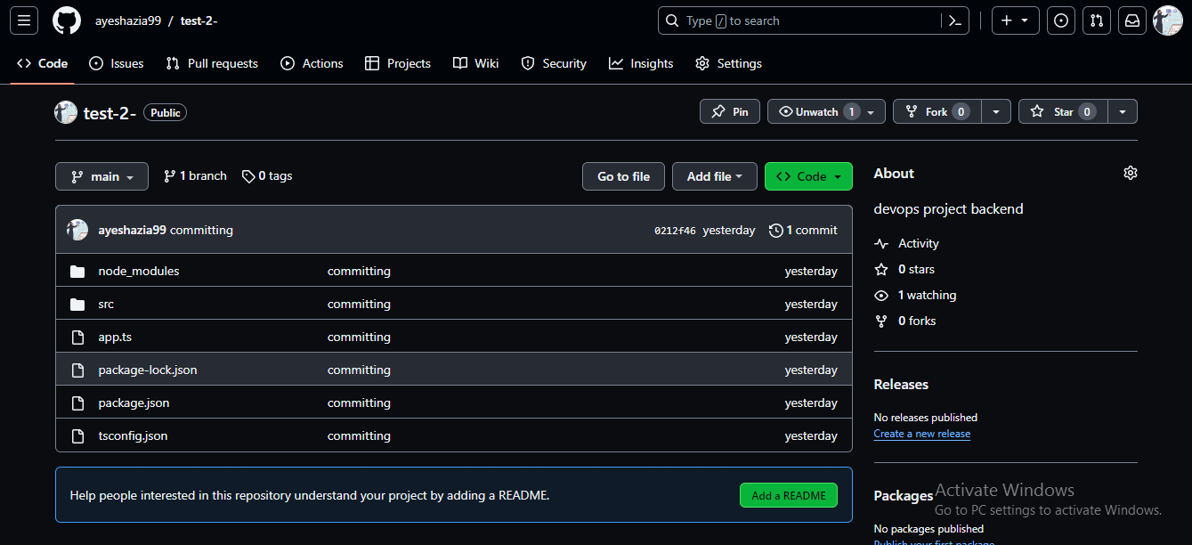
Backend(GitHub)

Slide 6
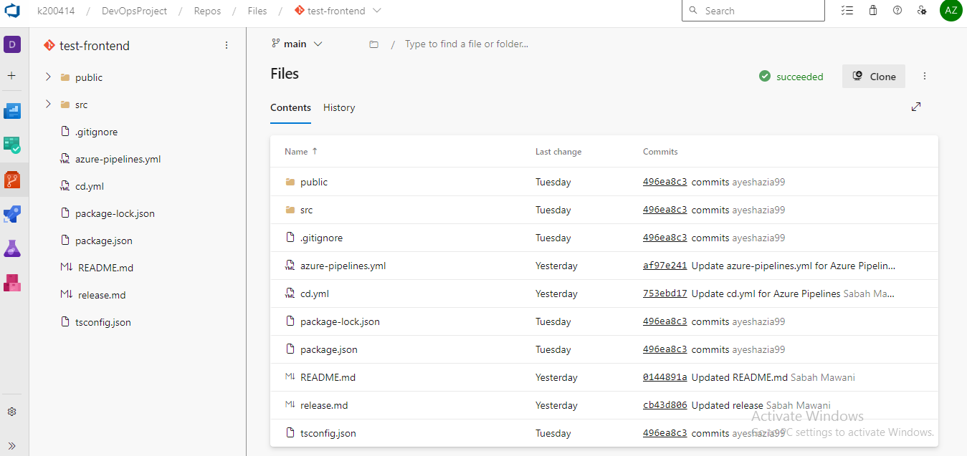
Frontend(Azure)

Slide 7
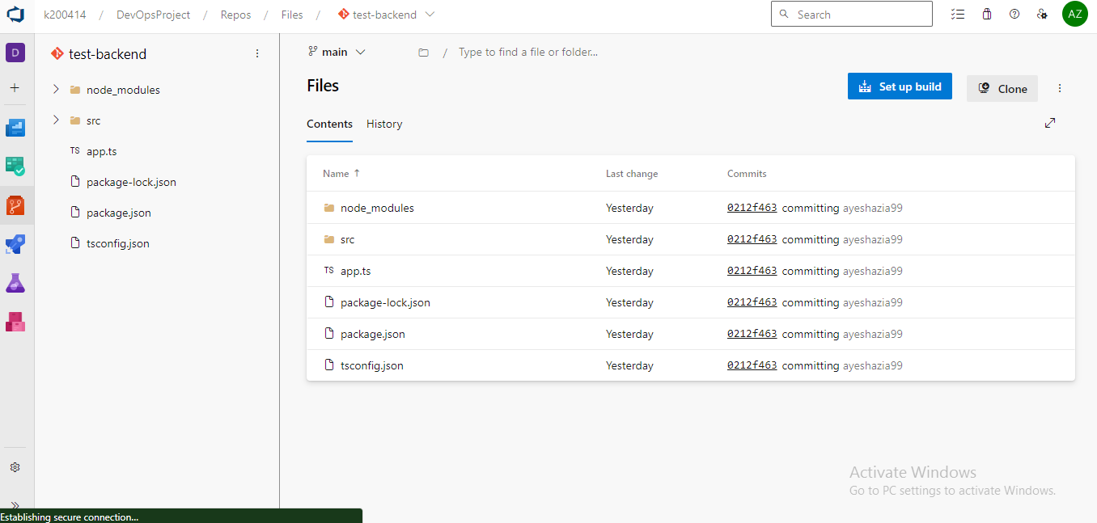
Backend(Azure)

Slide 8
Branch Policies

Slide 9
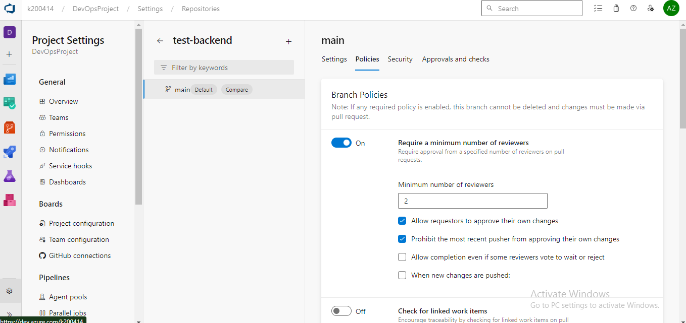

Slide 10
Continuous Integration Pipeline & Continuous Deployment / Delivery (CD Pipeline - Release)

Slide 11
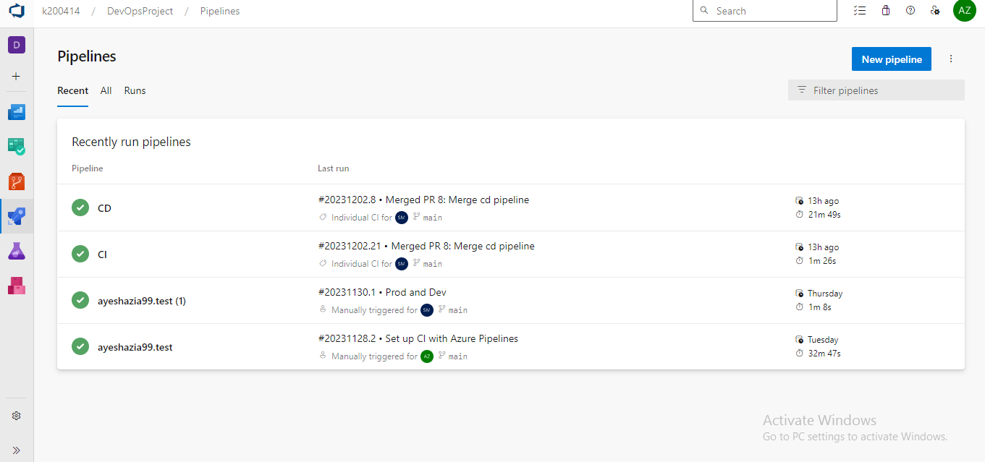
Pipelines

Slide 12
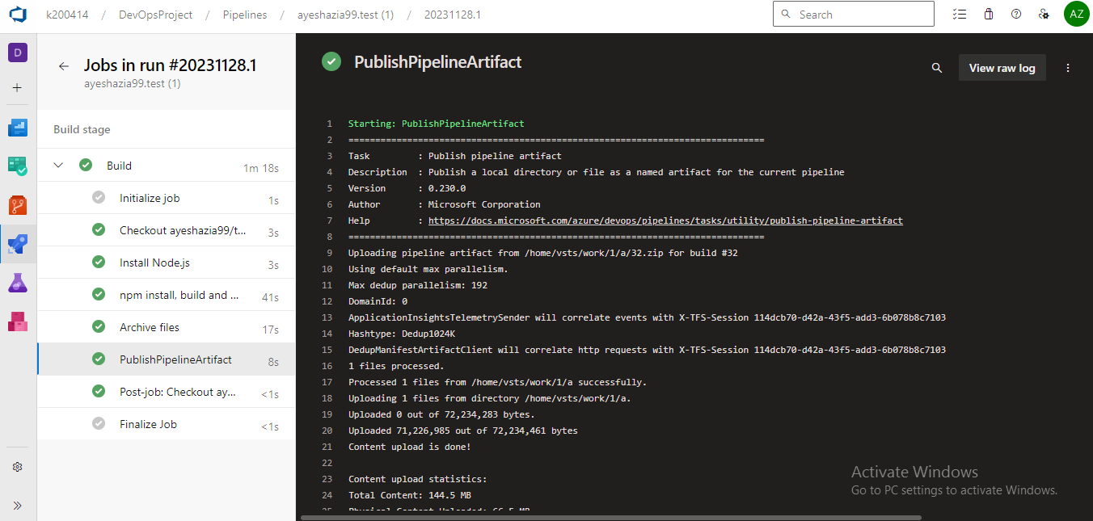
CI Pipeline

Slide 13
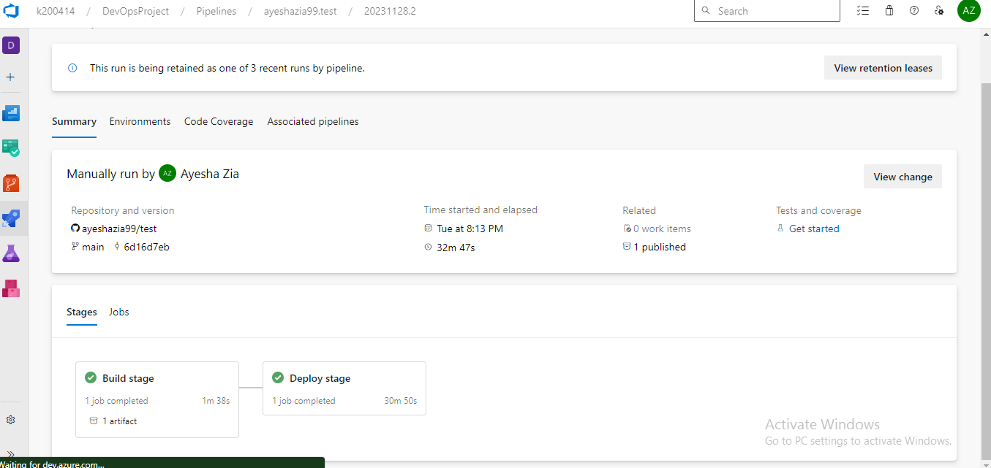
CD Pipeline

Slide 14
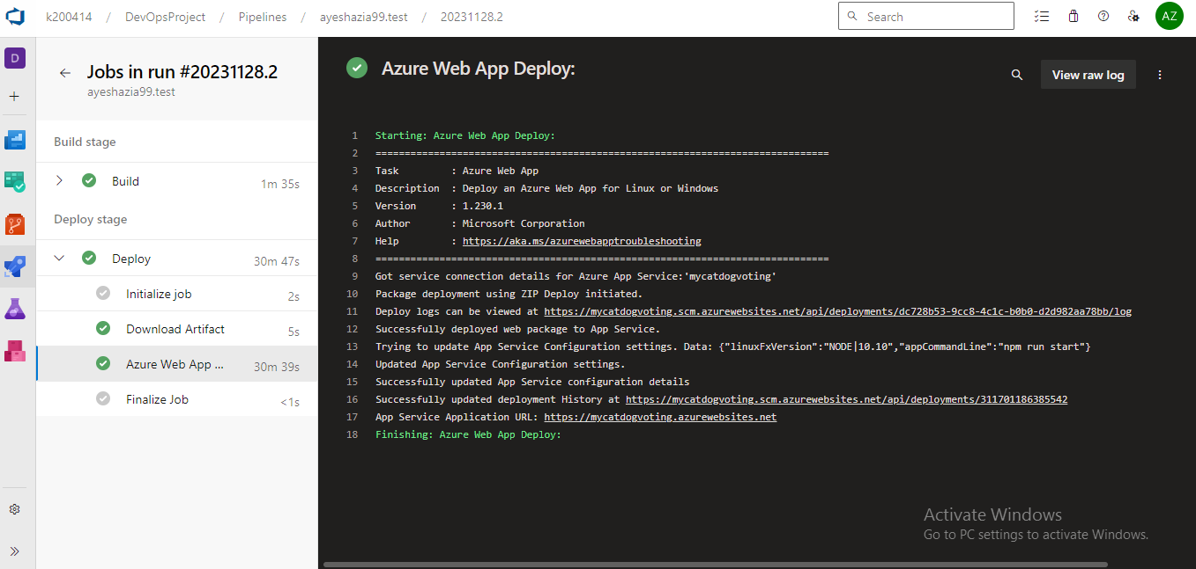
CD Pipeline

Slide 15
Unit Testing

Slide 16
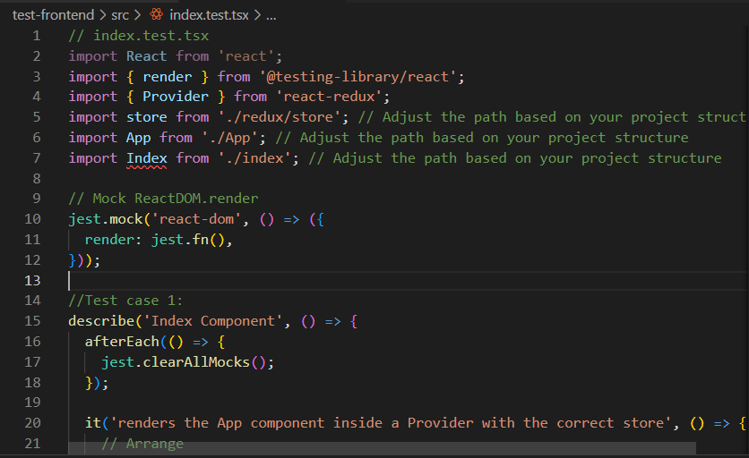

Slide 17
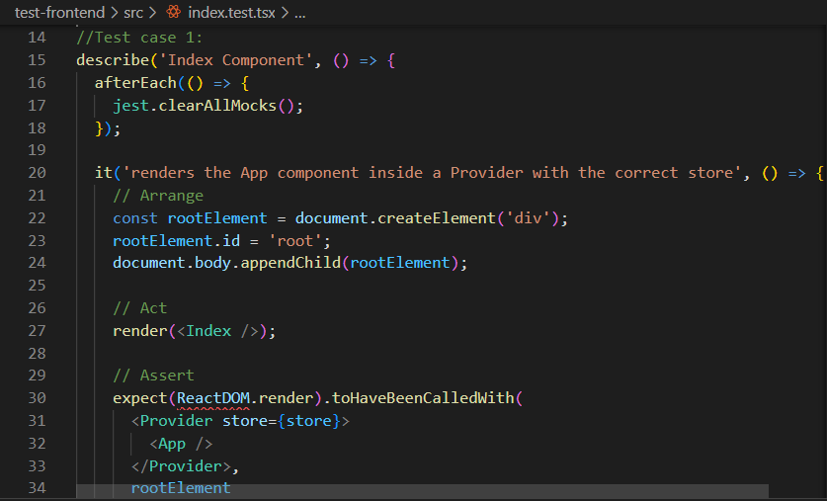

Slide 18
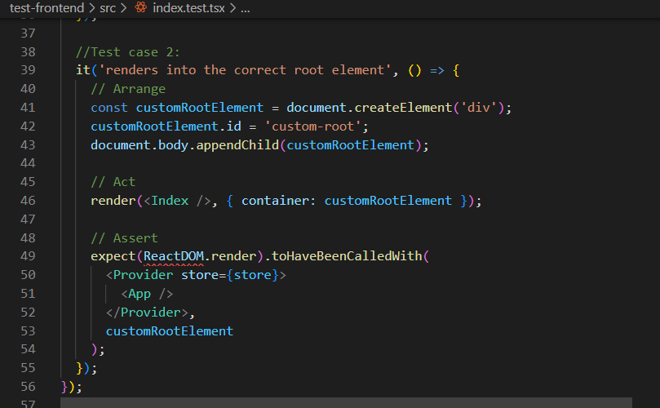

Slide 19
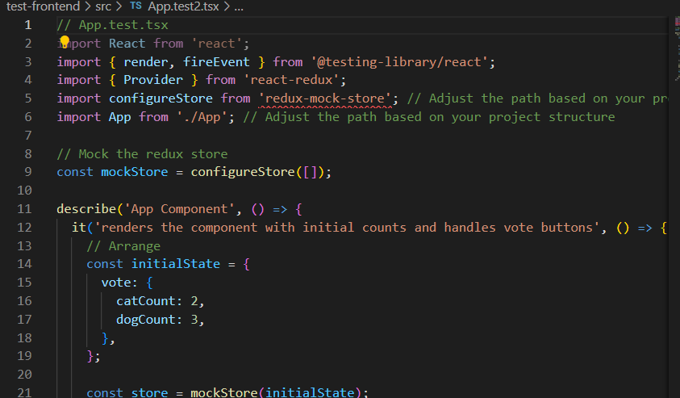

Slide 20
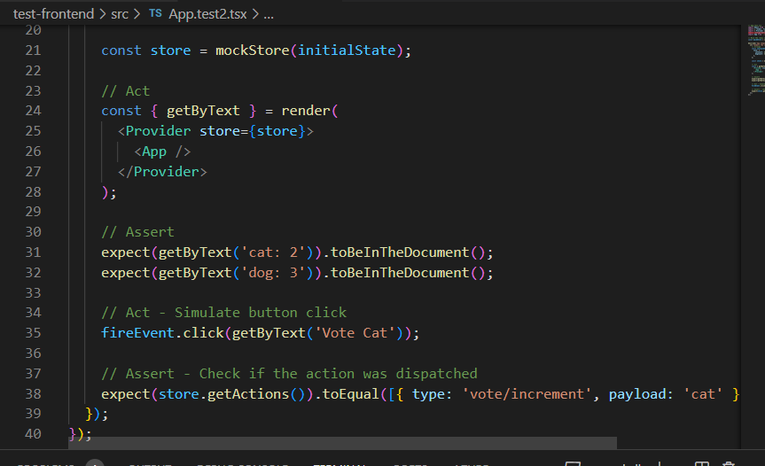

Slide 21
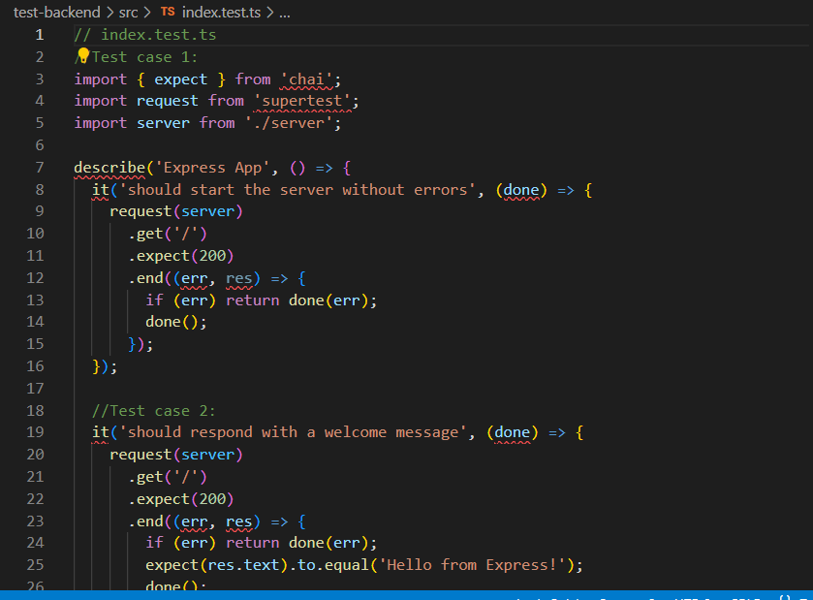

Slide 22
Azure Boards

Slide 23
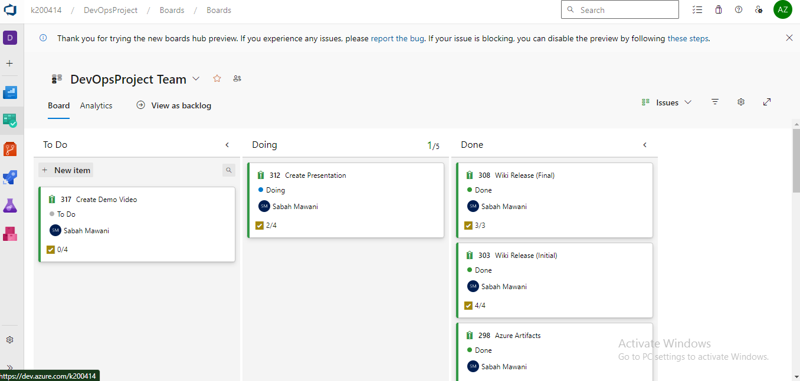

Slide 24
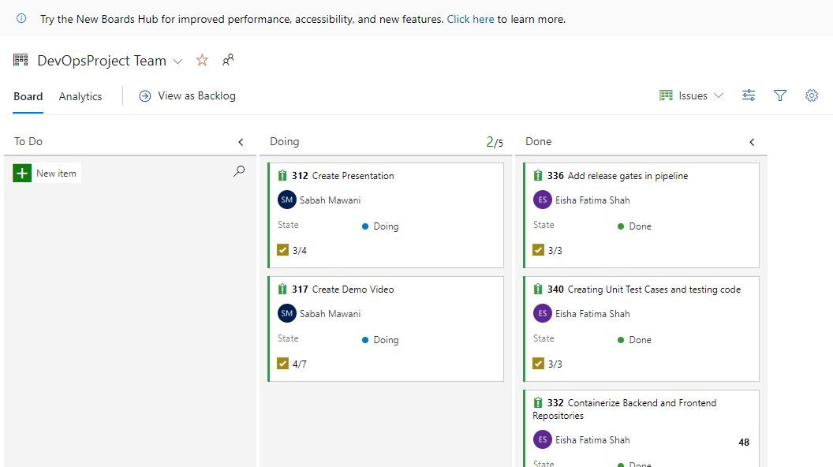
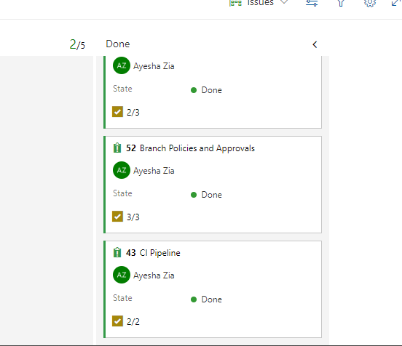

Slide 25
Release Gates

Slide 26
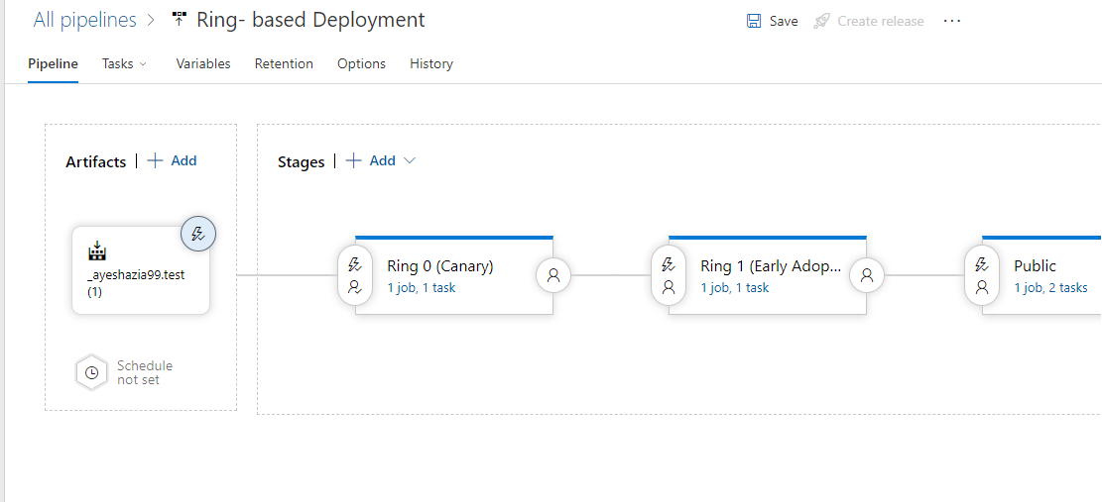

Slide 27
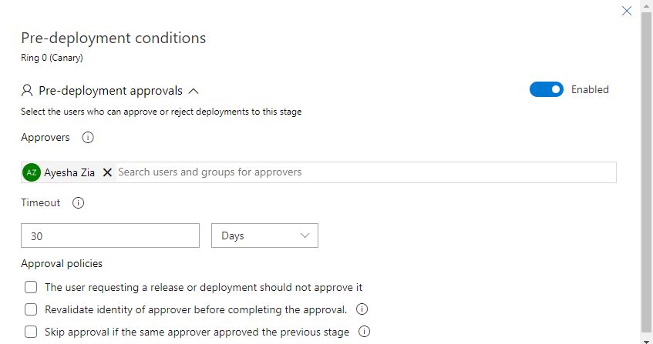

Slide 28
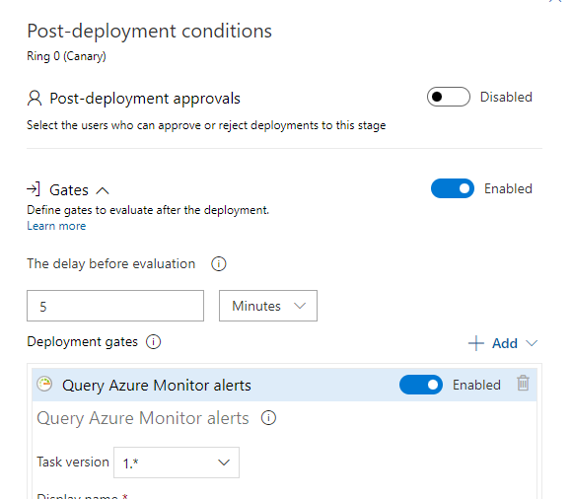

Slide 29
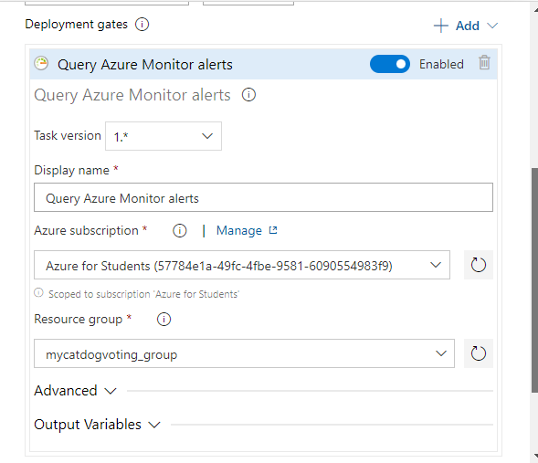

Slide 30
Integration with Azure DevOps Dashboard

Slide 31
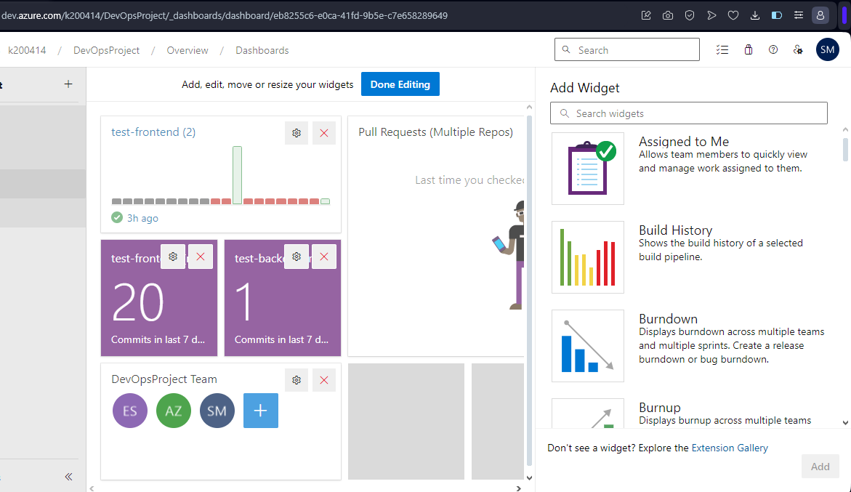

Slide 32
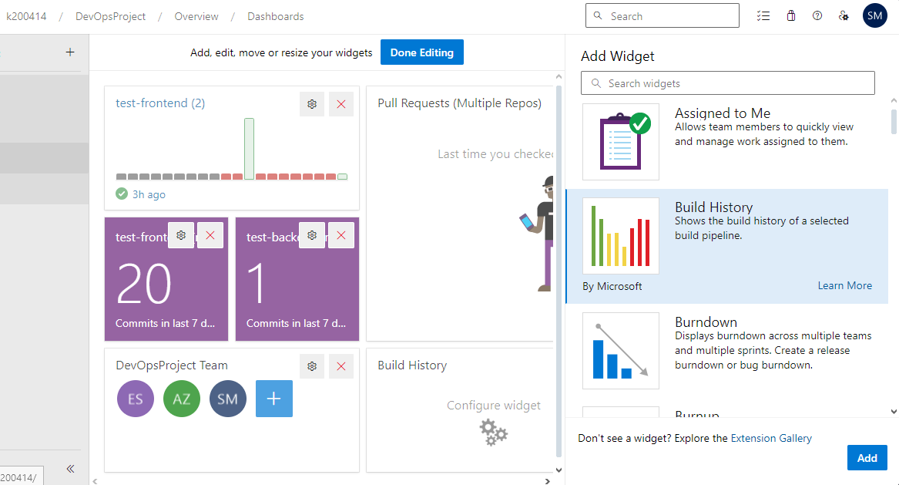

Slide 33
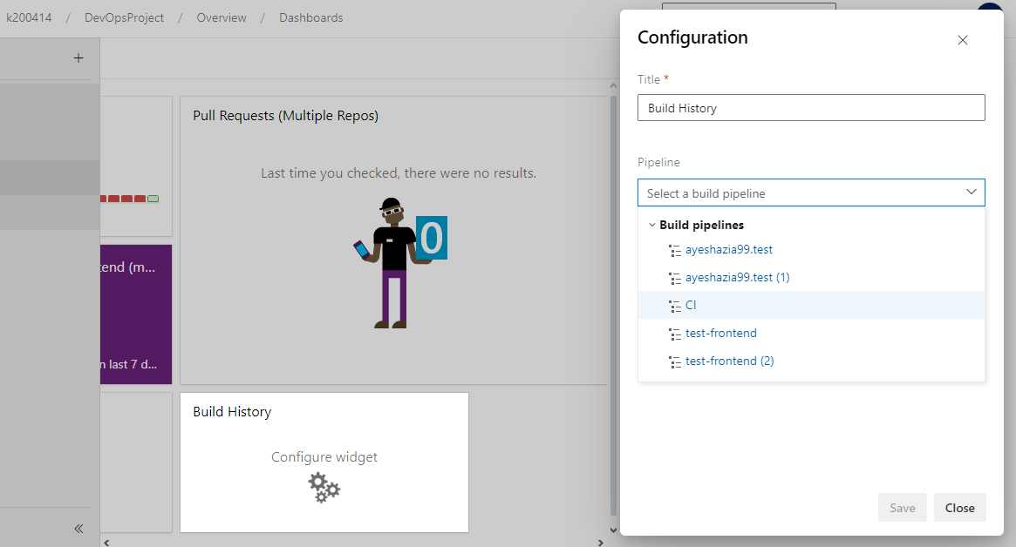

Slide 34
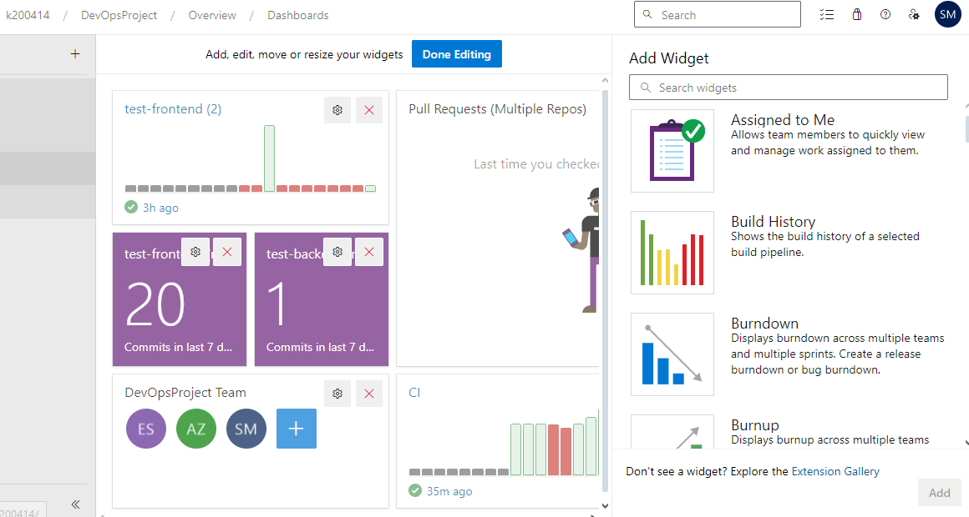

Slide 35
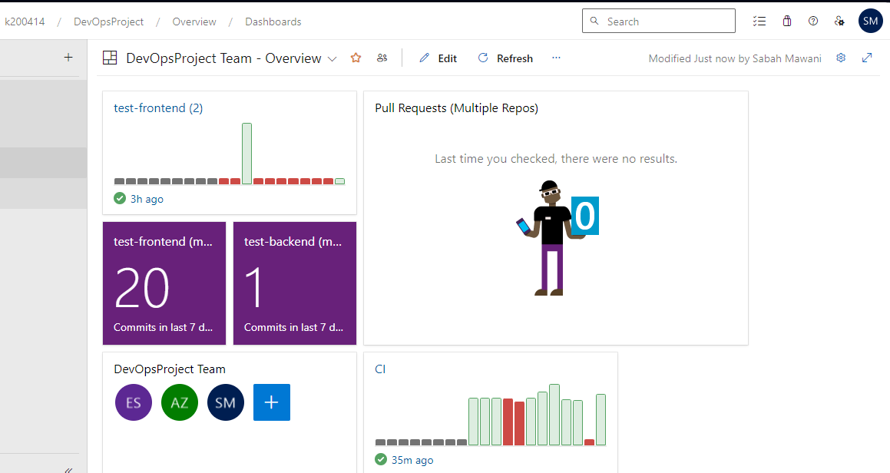

Slide 36
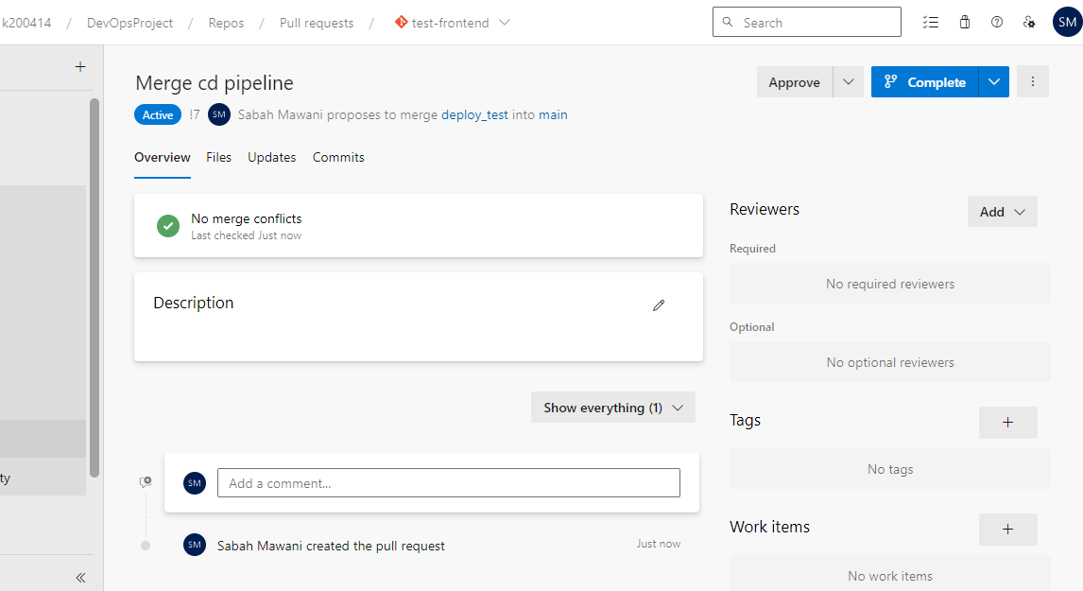

Slide 37
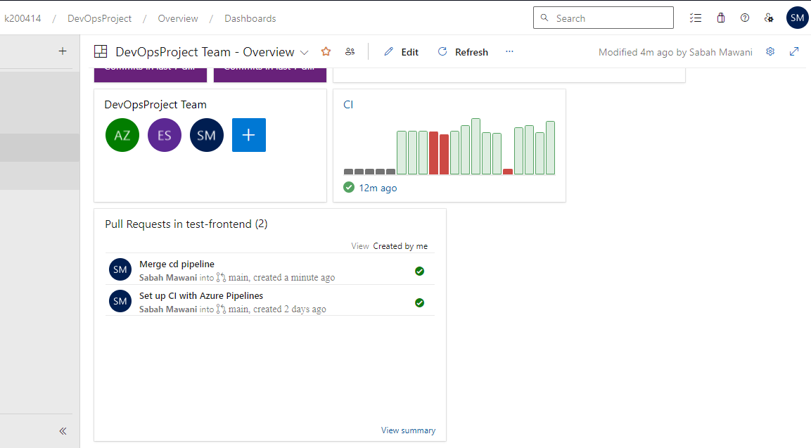

Slide 38
Integration with Slack

Slide 39
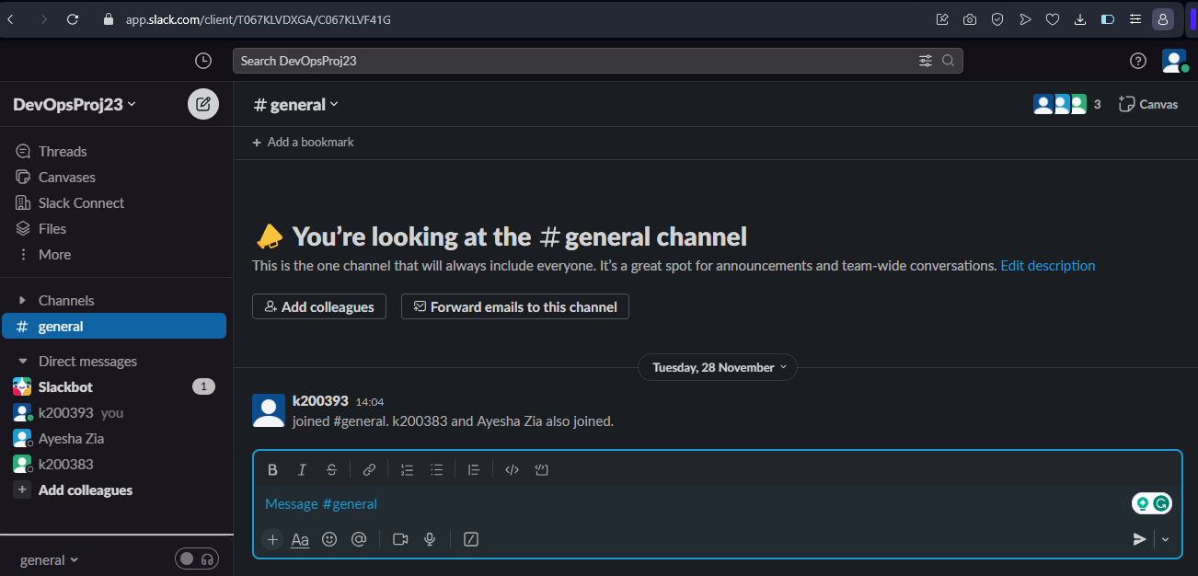

Slide 40
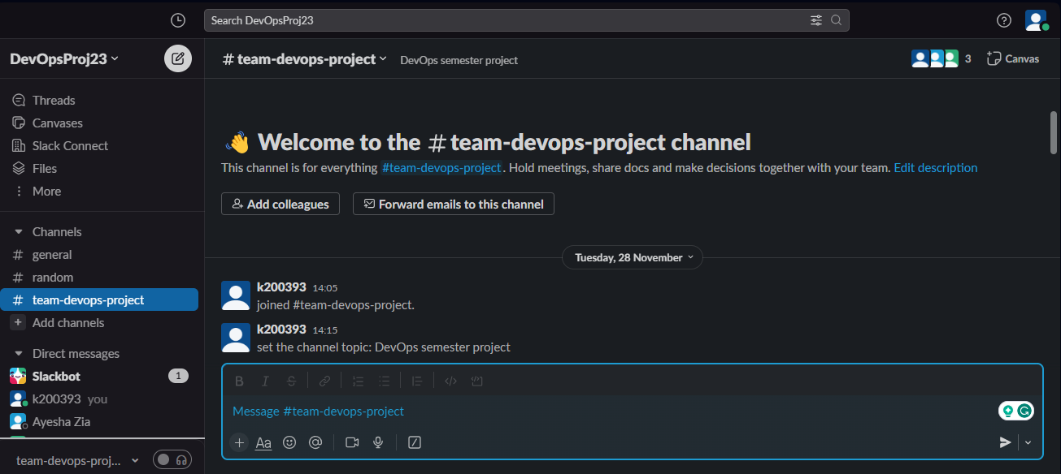

Slide 41
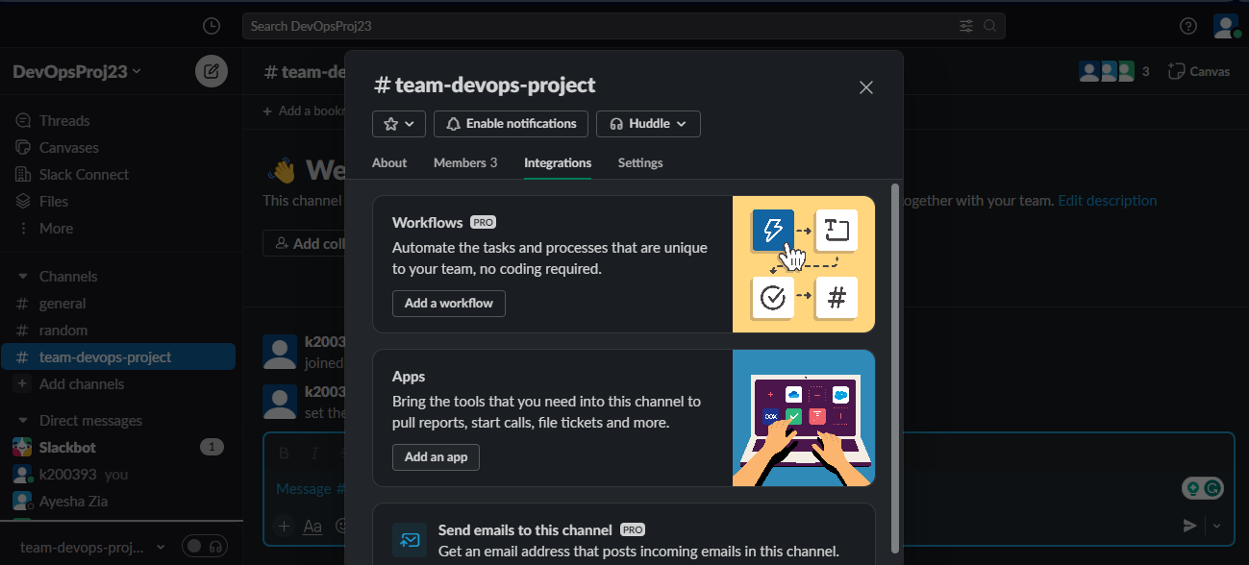

Slide 42
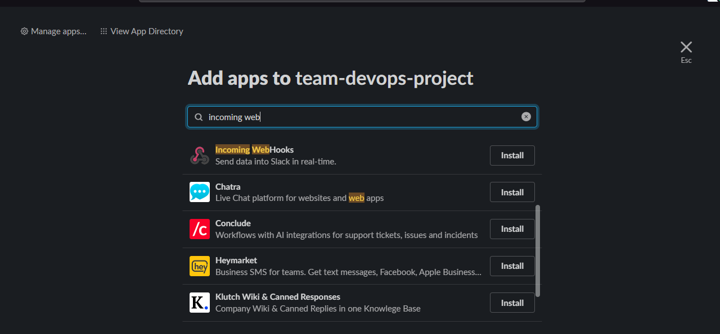

Slide 43
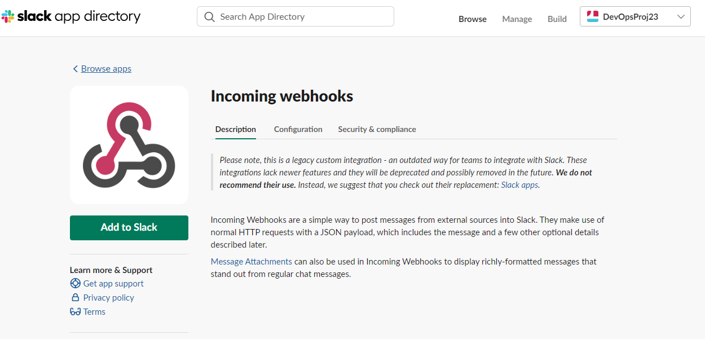

Slide 44
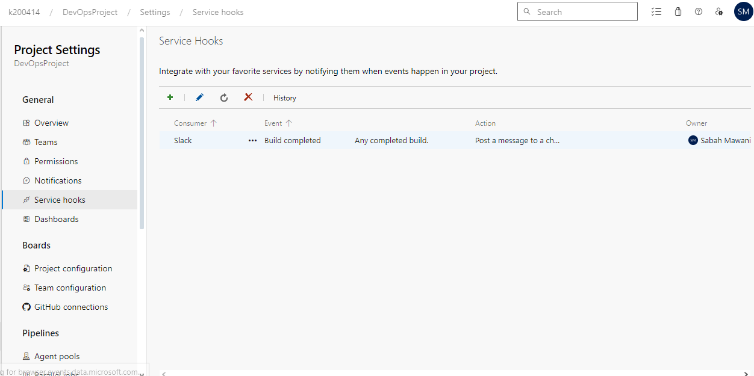

Slide 45
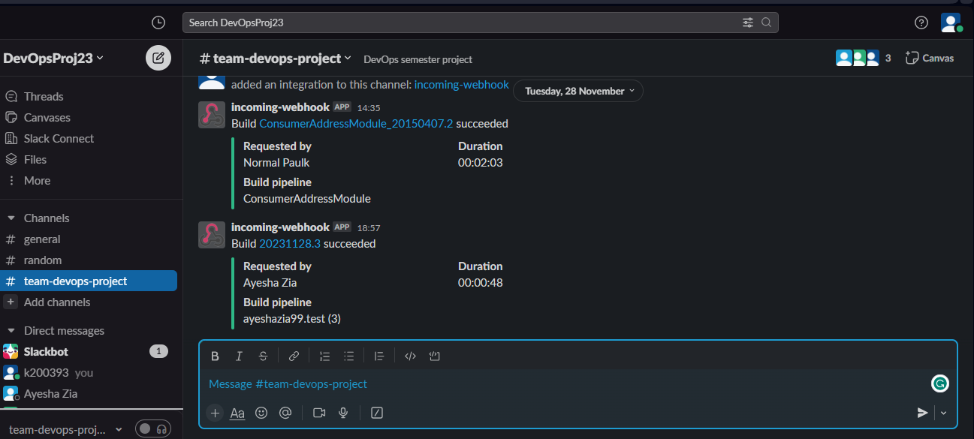

Slide 46
Resource Group & App Service

Slide 47
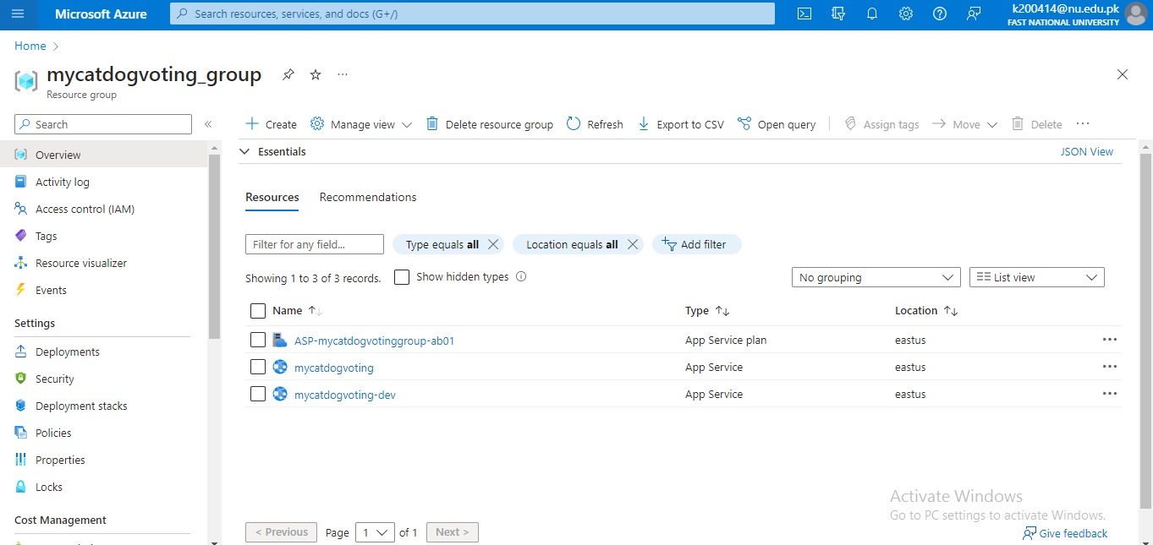

Slide 48
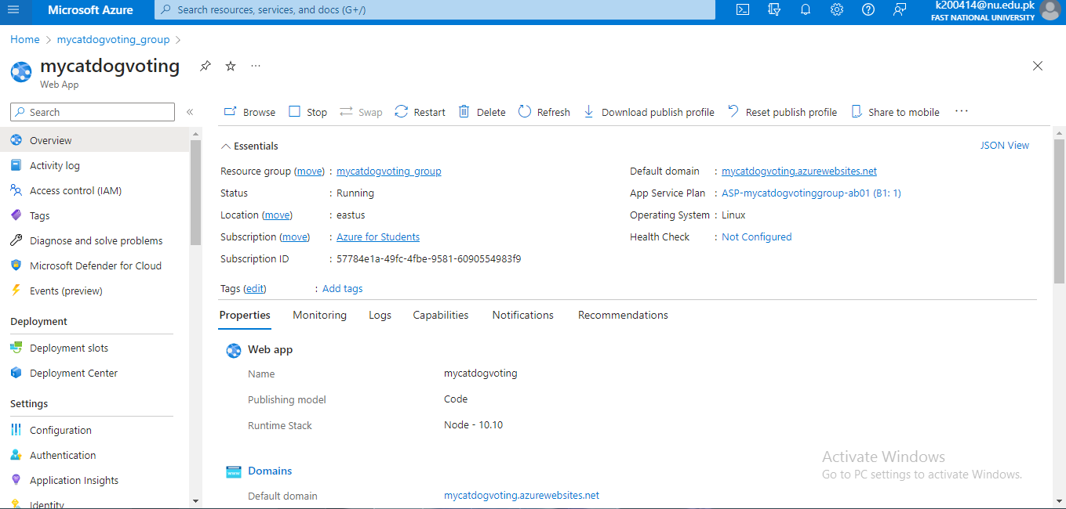

Slide 49
Deployment Rings (With Slow, Fast and Production Rings)

Slide 50
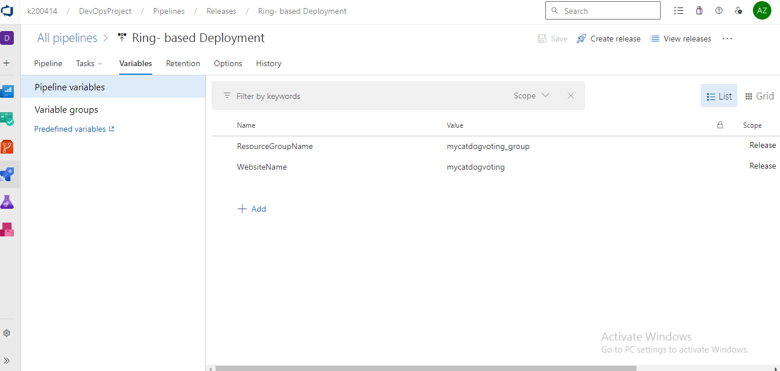

Slide 51
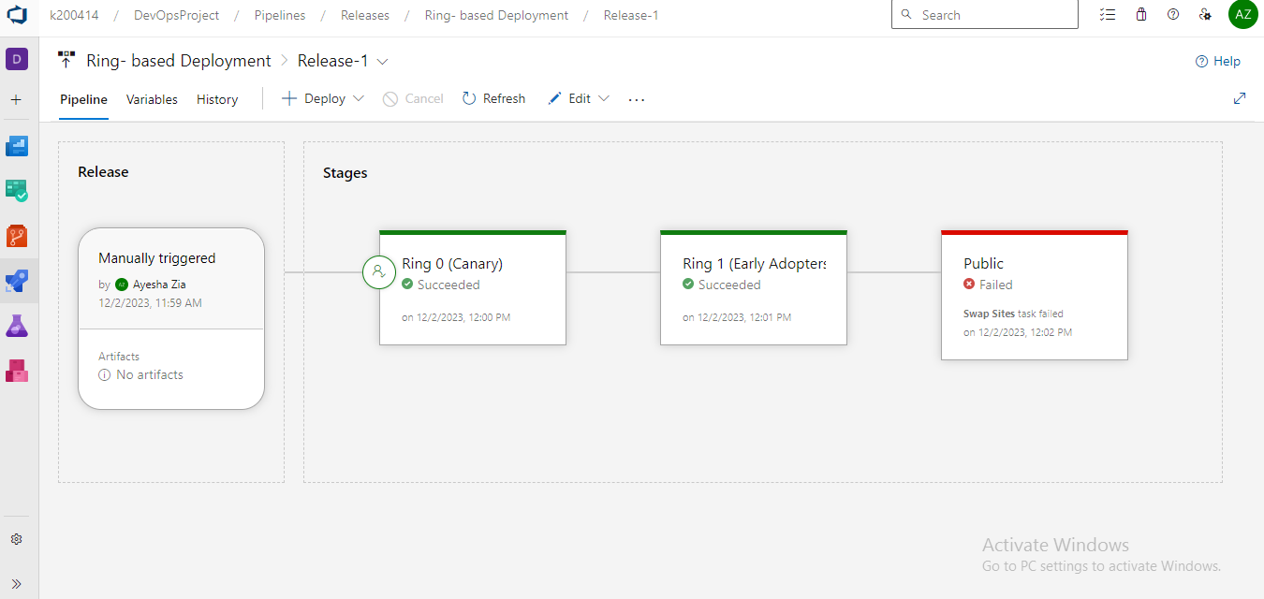
Failed as subscription
needed for
deployment slot

Slide 52
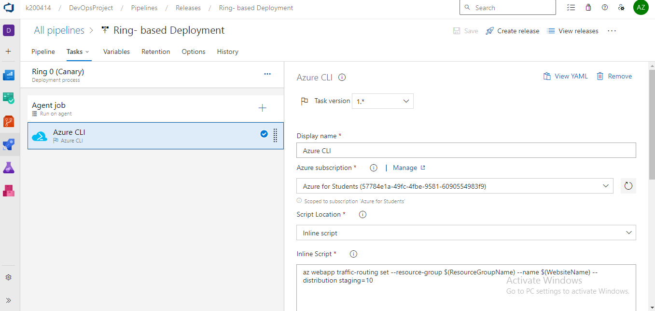

Slide 53
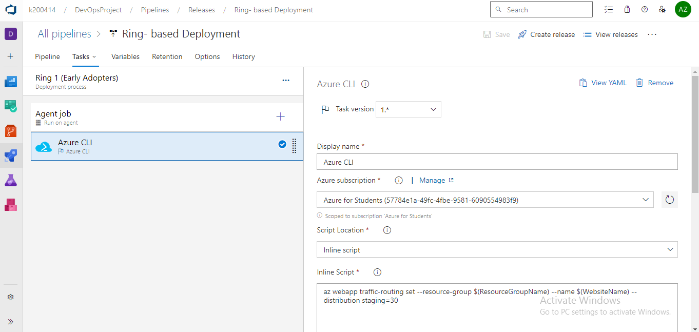

Slide 54
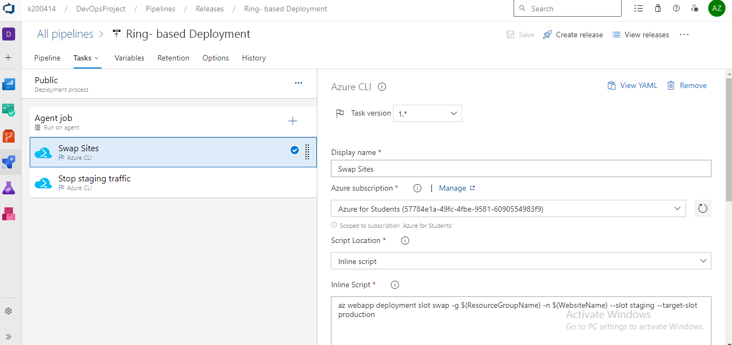

Slide 55
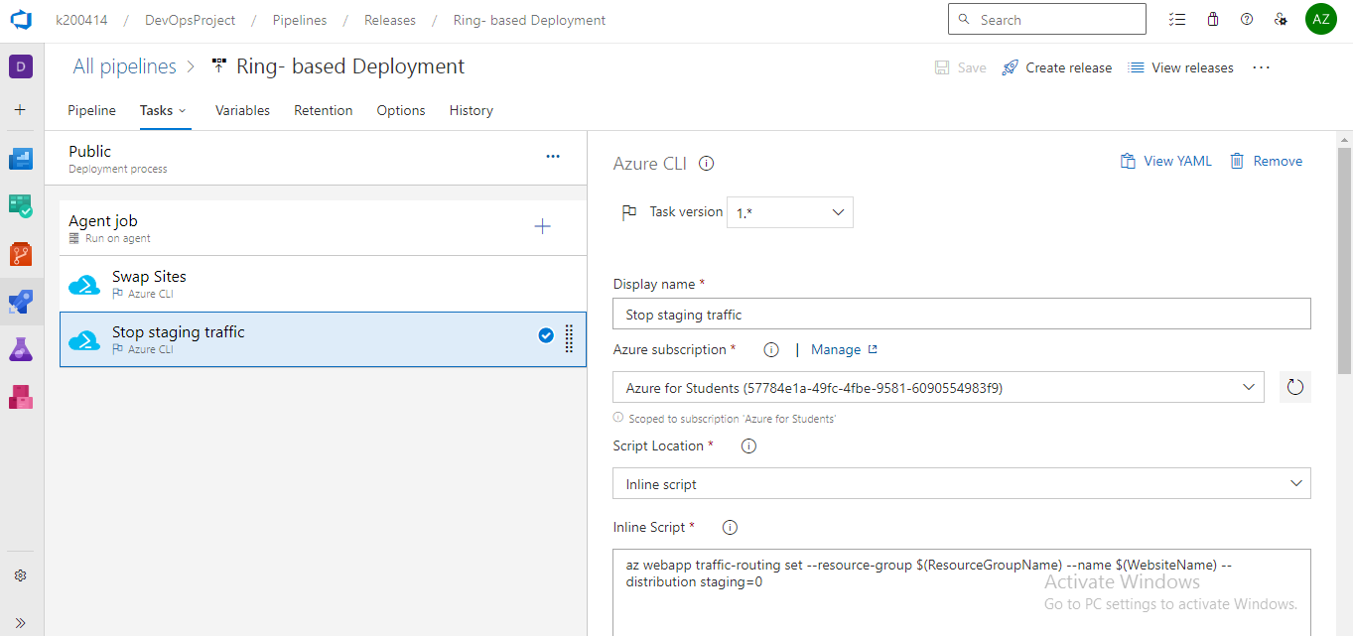

Slide 56
Containerization

Slide 57
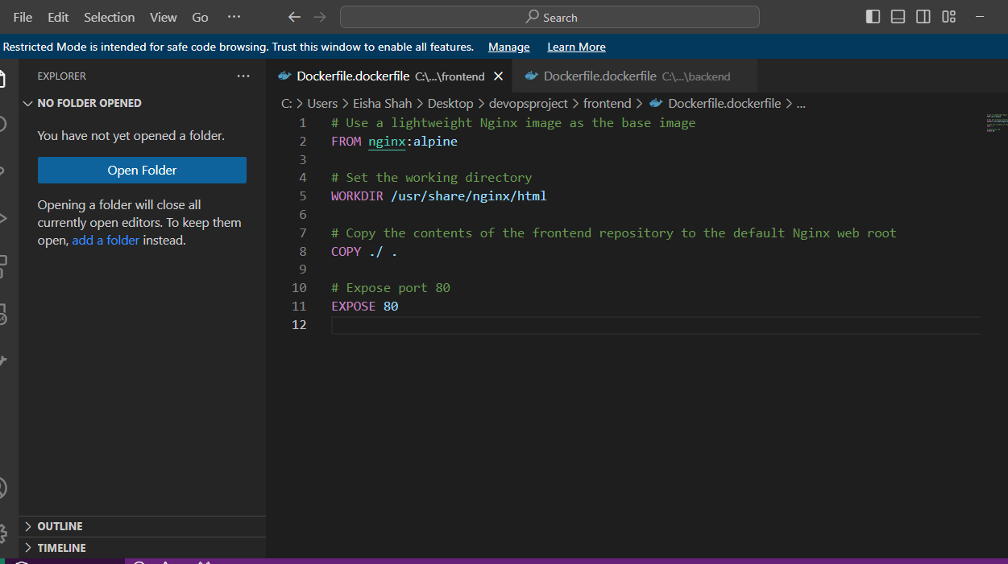

Slide 58
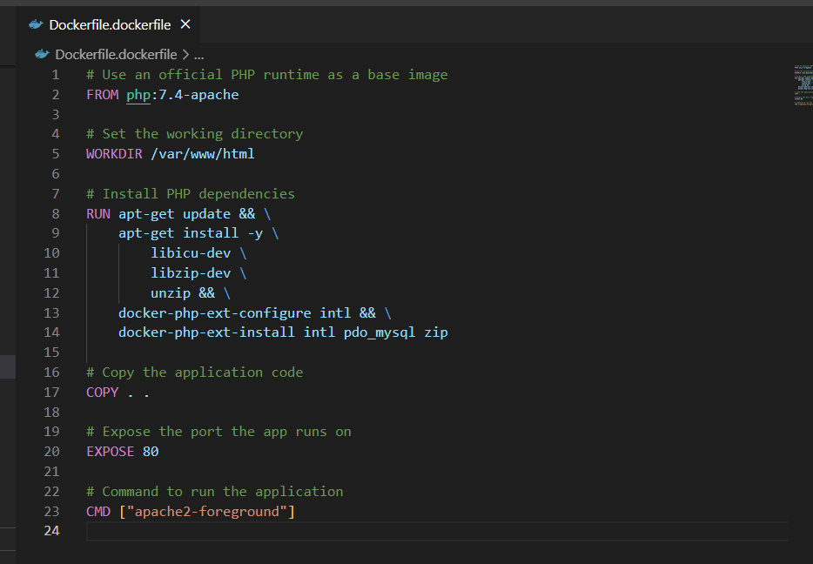

Slide 59
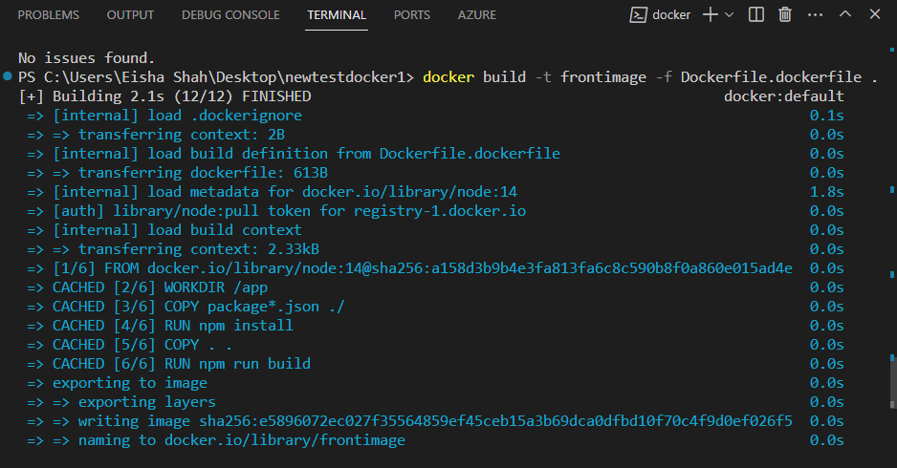
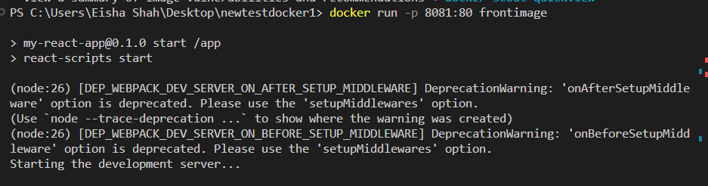

Slide 60
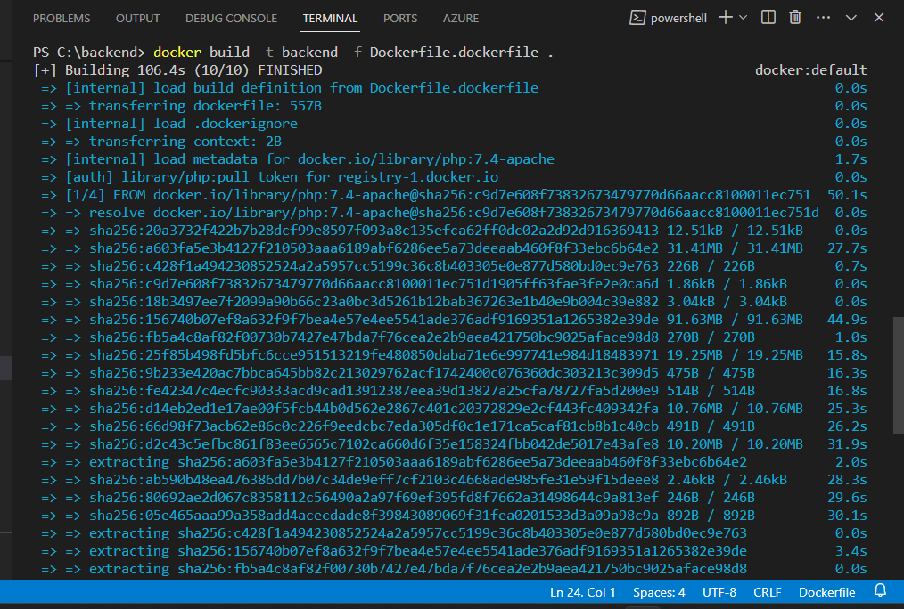


Slide 61


Slide 62


Slide 63


Slide 64
Wiki (Release Notes)

Slide 65


Slide 66


Slide 67


Slide 68
Azure Artifact

Slide 69


Slide 70


Slide 71


Slide 72


Slide 73


